Slide 1
ITEC100 – Preparation for Domain 4 Post-Assessment
Tutor: Dr. Farshid Keivanian

Slide 2
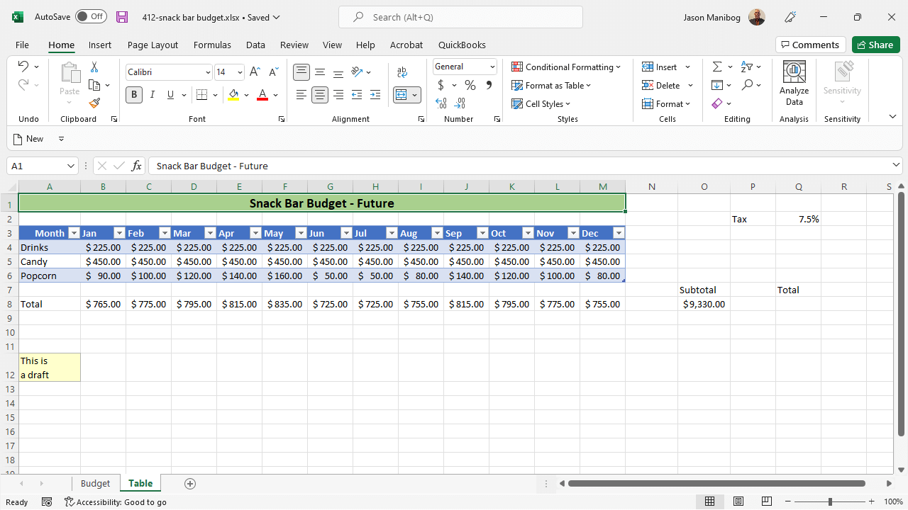
In cell Q8 on the current worksheet, use the ribbon to multiply the named ranges future_budget and Tax_Rate.
1. Select Cell Q8: Click on cell Q8 to ensure it is selected.
2. Go to the "Formulas" Tab: At the top of Excel, click on the "Formulas" tab in the ribbon.
3. Insert Function: Click on the "Insert Function" button, which is typically the first button on the left of the "Formulas" tab.

Slide 3
In cell Q8 on the current worksheet, use the ribbon to multiply the named ranges future_budget and Tax_Rate.
4. Select the Multiply Operation:
In the "Insert Function" dialog, choose a simple multiplication operation by typing = in cell Q8 directly.
Alternatively, you can write the formula manually if you prefer.
5. Type the Formula:
In cell Q8, type = and then type or select the named ranges future_budget and Tax_Rate.
The final formula should look like this: =future_budget * Tax_Rate.
6. Press Enter: After entering the formula, press Enter to complete the operation.
The result in cell Q8 will be the product of the values from the named ranges future_budget and Tax_Rate.

Slide 4
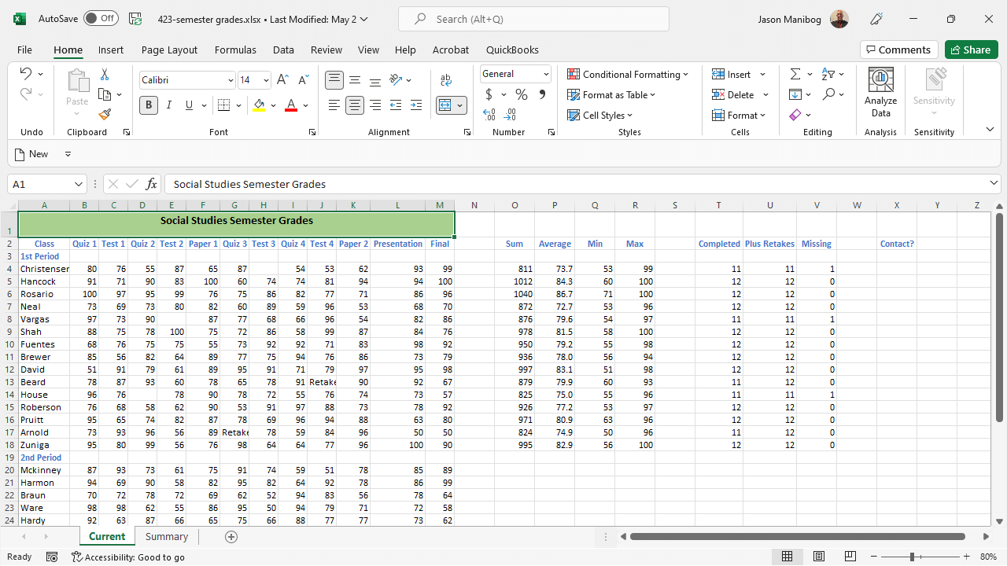
In cell X4, add a function that will display the word YES if cell V4 is greater than zero; if not, the cell should remain blank.
To add a function in cell X4 that will display the word "YES" if cell V4 is greater than zero, and remain blank if it is not, follow these steps:
Select Cell X4: Click on cell X4 to ensure it is active.
Enter the Formula:
In the formula bar, type the following formula:
=IF(V4>0,"YES","")
This formula checks if the value in cell V4 is greater than zero. If it is, the function returns "YES". If not, it returns an empty string, which will leave the cell blank.
3. Press Enter: After typing the formula, press Enter to apply it.
Now, cell X4 will display "YES" if the value in V4 is greater than zero, otherwise, it will remain blank.

Slide 5
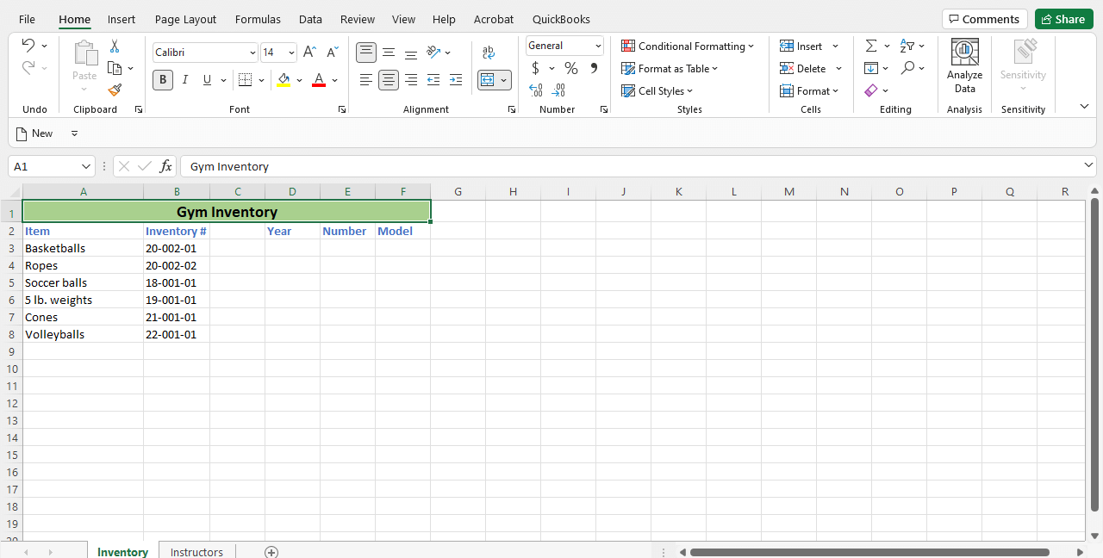
On the Inventory worksheet, use the ribbon to extract the two leftmost characters from cell B3 into cell D3. Then, in cell F3, type the formula needed to extract the rightmost two characters from cell B3 and display the results.
To accomplish the tasks described on the Inventory worksheet, follow these steps:
Step 1: Extract the Two Leftmost Characters from Cell B3 into Cell D3
Select Cell D3: Click on cell D3 to make it active.
Go to the "Formulas" Tab in the Ribbon:
Click on the "Formulas" tab at the top of Excel.
Insert the LEFT Function:
In the "Function Library" group, click on "Text" to open the drop-down menu.
Choose "LEFT" from the list.

Slide 6
On the Inventory worksheet, use the ribbon to extract the two leftmost characters from cell B3 into cell D3. Then, in cell F3, type the formula needed to extract the rightmost two characters from cell B3 and display the results.
4. Configure the LEFT Function:
In the "Function Arguments" dialog box:
For "Text," select cell B3 by clicking on it or typing B3.
For "Num_chars," type 2 to extract the first two characters.
Click "OK."
Now, cell D3 should display the two leftmost characters from cell B3.

Slide 7
On the Inventory worksheet, use the ribbon to extract the two leftmost characters from cell B3 into cell D3. Then, in cell F3, type the formula needed to extract the rightmost two characters from cell B3 and display the results.
Step 2: Extract the Rightmost Two Characters from Cell B3 into Cell F3
Select Cell F3: Click on cell F3 to make it active.
Enter the Formula:
In the formula bar, type the following formula:
=RIGHT(B3,2)

Slide 8
On the Inventory worksheet, use the ribbon to extract the two leftmost characters from cell B3 into cell D3. Then, in cell F3, type the formula needed to extract the rightmost two characters from cell B3 and display the results.
This formula extracts the two rightmost characters from cell B3.
3. Press Enter: After typing the formula, press Enter to apply it.
Now, cell F3 should display the two rightmost characters from cell B3.

Slide 9
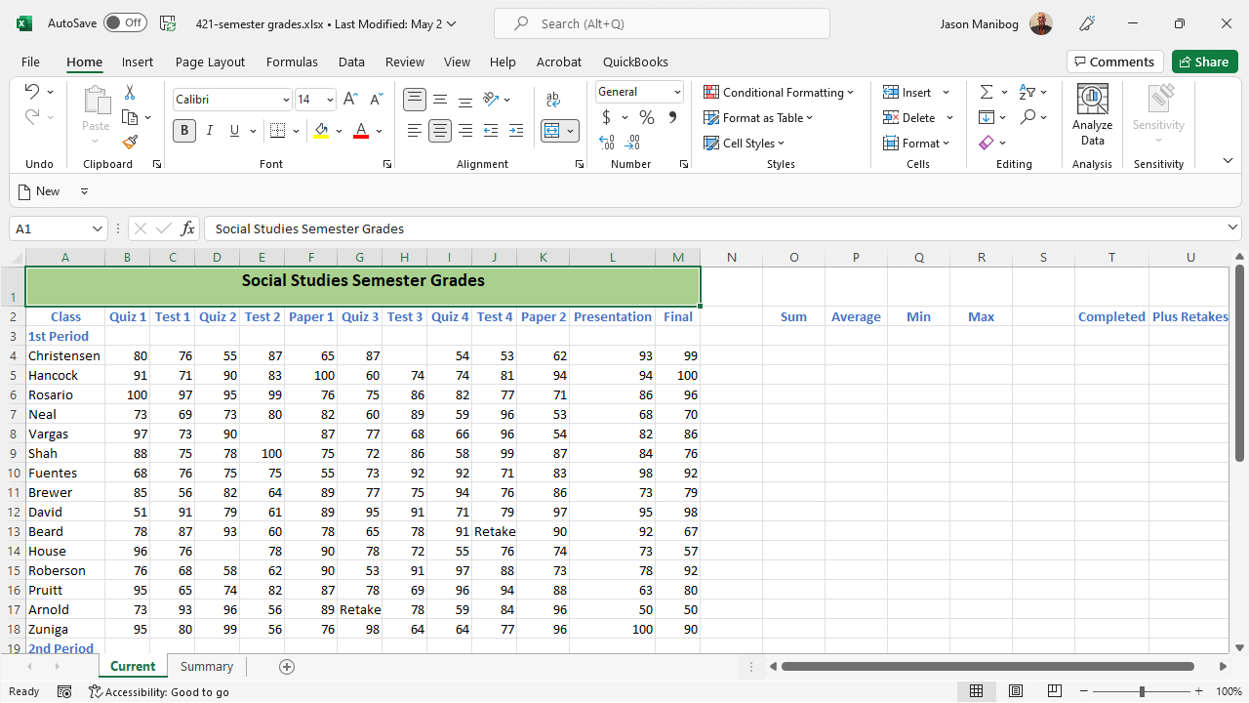
In cell O4, type the function that will add up the total scores in cells B4 through M4. Then, in cell R4, use the Function Library to obtain and add the function that will display the highest score in cells B4 through M4.
Step-by-Step Solution
Step 1: Add Up the Total Scores in Cells B4 through M4
Select Cell O4: Click on cell O4 to make it active.
Enter the SUM Function:
In the formula bar, type the following formula:
=SUM(B4:M4)
This formula adds up all the scores from cells B4 through M4.
3. Press Enter: After typing the formula, press Enter to apply it.
Now, cell O4 will display the total sum of the scores from B4 to M4.

Slide 10
In cell O4, type the function that will add up the total scores in cells B4 through M4. Then, in cell R4, use the Function Library to obtain and add the function that will display the highest score in cells B4 through M4.
Step 2: Display the Highest Score in Cells B4 through M4
Select Cell R4: Click on cell R4 to make it active.
Go to the "Formulas" Tab in the Ribbon:
Click on the "Formulas" tab at the top of Excel.
Insert the MAX Function:
In the "Function Library" group, click on "More Functions" if necessary, then select "Statistical" and choose "MAX" from the list.
In the "Function Arguments" dialog box:
For "Number1," select the range B4 by either typing B4:M4 or by dragging to select these cells.

Slide 11
In cell O4, type the function that will add up the total scores in cells B4 through M4. Then, in cell R4, use the Function Library to obtain and add the function that will display the highest score in cells B4 through M4.
4. Click OK: After configuring the function, click "OK."
Now, cell R4 will display the highest score from the range B4 through M4.

Slide 12

In cell D3 on the Instructors worksheet, add a function to combine Amy, a space, and Jones, using the cells containing Amy and Jones.
Here’s a step-by-step solution to accomplish this in Excel:
Step 1: Identify the Cells
Go to the Instructors worksheet.
Identify the cells that contain "Amy" and "Jones". For this example, let's assume:
"Amy" is in cell B3.
"Jones" is in cell C3.

Slide 13
In cell D3 on the Instructors worksheet, add a function to combine Amy, a space, and Jones, using the cells containing Amy and Jones.
Step 2: Enter the Function
In cell D3, enter the following formula:
=B3 & " " & C3
Explanation:
B3 refers to the cell containing "Amy".
" " represents a space.
C3 refers to the cell containing "Jones".
The & operator is used to concatenate (combine) the text in the cells with the space between them.

Slide 14
In cell D3 on the Instructors worksheet, add a function to combine Amy, a space, and Jones, using the cells containing Amy and Jones.
Step 3: Press Enter
After typing the formula in cell D3, press Enter.
The result in cell D3 should be "Amy Jones".
This completes the task of combining "Amy" and "Jones" with a space between them in cell D3.

Slide 15

In cell F4 on the current worksheet, add a function that will sort the January activities in ascending order. Then, starting in cell G4, list each activity from the January activities without duplicating any activity.
Step-by-Step Solution:
Step 1: Sort the January Activities in Ascending Order
Identify the Range of January Activities:
The January activities are listed in column A from cells A3 to A18.
Sort the Activities Alphabetically in Column F:
In cell F4, enter the following formula to sort the January activities alphabetically:
=SORT(A3:A18)
This will automatically sort the activities in ascending alphabetical order.

Slide 16
In cell F4 on the current worksheet, add a function that will sort the January activities in ascending order. Then, starting in cell G4, list each activity from the January activities without duplicating any activity.
Step 2: List Each Unique January Activity Without Duplicates
List Unique Activities in Column G:
Starting in cell G4, enter the following formula to extract unique activities from the sorted list:
=UNIQUE(F4:F18)
This will list each unique activity from the January activities without any duplicates.
By following these steps, you will have the sorted January activities in column F and the unique activities without duplicates in column G.

Slide 17
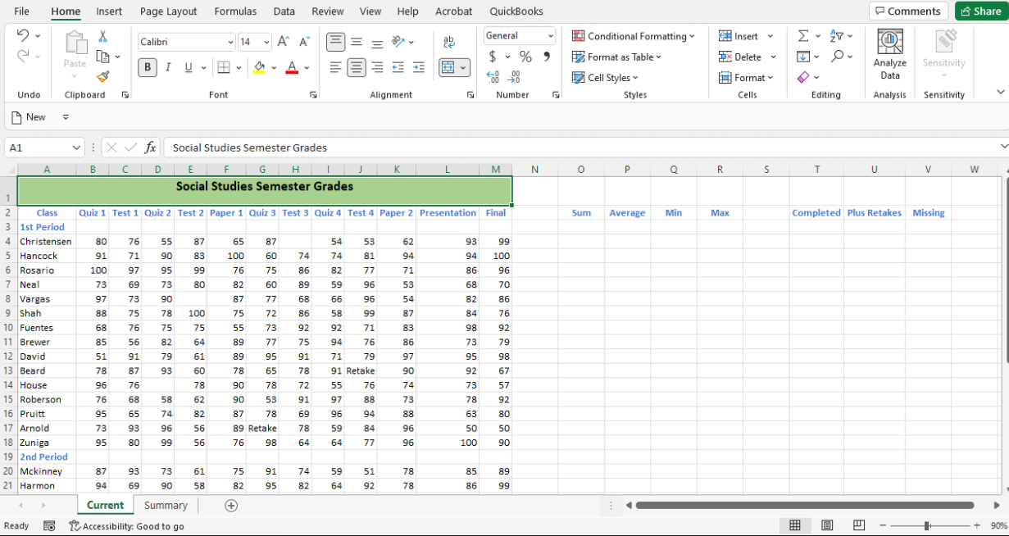
Using the data in cells B4 through M4, add a count function in cell T4 that counts all the scores. Using the same data, in cell U4, add a count function to count all the scores and retakes. Using the same data, in cell V4, add a count function to count all the cells containing no text or numbers.
Step-by-Step Solution:
Count All Scores in Cell T4:
To count all the scores in the range B4
, you can use the COUNT function in Excel.
Formula: =COUNT(B4:M4)
This formula will count the number of cells that contain numeric values within the range B4

Slide 18
Using the data in cells B4 through M4, add a count function in cell T4 that counts all the scores. Using the same data, in cell U4, add a count function to count all the scores and retakes. Using the same data, in cell V4, add a count function to count all the cells containing no text or numbers.
2. Count All Scores and Retakes in Cell U4:
If retakes are also numeric values, you can use the COUNT function again. However, if "Retake" is a text entry, you'll need a different approach.
Formula: =COUNTA(B4:M4)
The COUNTA function counts all non-empty cells in the range, so this will include both numbers and any text like "Retake."

Slide 19
Using the data in cells B4 through M4, add a count function in cell T4 that counts all the scores. Using the same data, in cell U4, add a count function to count all the scores and retakes. Using the same data, in cell V4, add a count function to count all the cells containing no text or numbers.
3. Count All Cells Containing No Text or Numbers in Cell V4:
To count the cells that are empty (contain no text or numbers), you can use the COUNTBLANK function.
Formula: =COUNTBLANK(B4:M4)
This will count all the blank cells within the specified range.
By entering these formulas into the respective cells (T4, U4, and V4), you can calculate the required counts for each of the specified conditions.

Slide 20
Using the formula builder, in cell F3 on the Instructors worksheet, convert the data in cell A3 to all uppercase letters. Then, in cell H3, type out the formula used to convert the data in cell A3 to all lowercase letters and display the result.
Step-by-Step Solution:
Open the Excel File:
Open the Excel file you are working on, and navigate to the "Instructors" worksheet.
Locate Cell A3:
Find cell A3 on the "Instructors" worksheet. This cell contains the data that needs to be converted to uppercase.
3. Convert Text to Uppercase in Cell F3:
Click on cell F3.
In the formula bar, type the following formula:
=UPPER(A3)
Press Enter. The content in cell A3 will now appear in uppercase in cell F3.

Slide 21
Using the formula builder, in cell F3 on the Instructors worksheet, convert the data in cell A3 to all uppercase letters. Then, in cell H3, type out the formula used to convert the data in cell A3 to all lowercase letters and display the result.
4. Convert Text to Lowercase in Cell H3:
Click on cell H3.
In the formula bar, type the following formula:
=LOWER(A3)
Press Enter. The content in cell A3 will now appear in lowercase in cell H3.
Explanation:
The UPPER function converts all the letters in the referenced cell to uppercase.
The LOWER function converts all the letters in the referenced cell to lowercase.
By following these steps, you should be able to convert the data in cell A3 to both uppercase and lowercase in cells F3 and H3, respectively.

Slide 22
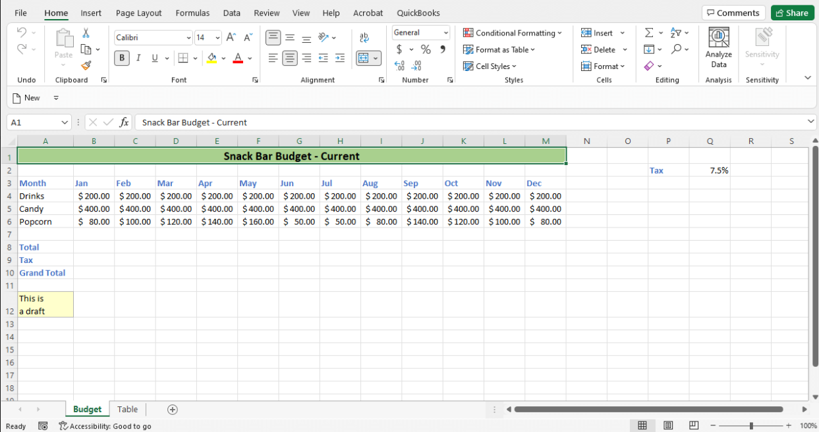
In cell B8 on the current worksheet, add a formula that will total the three budget items in cells B4 through B6. Then, in cell B9, type the formula that will multiply the total by the tax rate in cell Q2 and ensure that when this formula is copied using AutoFill, the tax rate cell is always Q2.
The task is to add formulas in Excel to achieve the following:
Calculate the total of three budget items in cells B4 through B6 and display the result in cell B8.
Multiply the total in B8 by the tax rate in cell Q2 and display the result in cell B9, ensuring that the reference to the tax rate is absolute so that it does not change when the formula is copied using AutoFill.

Slide 23
In cell B8 on the current worksheet, add a formula that will total the three budget items in cells B4 through B6. Then, in cell B9, type the formula that will multiply the total by the tax rate in cell Q2 and ensure that when this formula is copied using AutoFill, the tax rate cell is always Q2.
Step-by-Step Solution:
Add a formula in cell B8 to sum the budget items:
In cell B8, enter the formula: =SUM(B4:B6)
This formula adds the values in cells B4, B5, and B6.
Add a formula in cell B9 to multiply the total by the tax rate:
In cell B9, enter the formula: =B8*$Q$2
This formula multiplies the total in cell B8 by the tax rate in cell Q2.
The $ symbols before Q and 2 make the reference to cell Q2 absolute, so it will not change when the formula is copied to other cells.

Slide 24
In cell B8 on the current worksheet, add a formula that will total the three budget items in cells B4 through B6. Then, in cell B9, type the formula that will multiply the total by the tax rate in cell Q2 and ensure that when this formula is copied using AutoFill, the tax rate cell is always Q2.
By following these steps, the formulas will correctly calculate the total and apply the tax rate, ensuring that the tax rate reference remains constant even when the formula is copied to other cells using AutoFill.

Slide 25

Happy A Learning Day
Thank you
Dr. Farshid Keivanian

